Slide 1
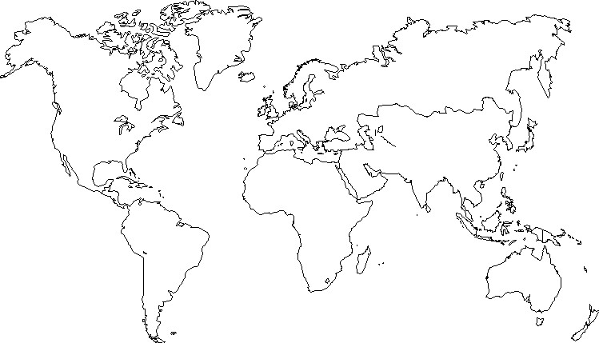
Greenland
Russia
Canada
Northen Lands
UK
Center Europe
France
Kazakstan
USA
Spain
Italy
china
Central Europe
Mexico
North Africa
Arabia
India
Sahel
S.E.Asia
CAmerica
Ethiopia
Equateur
Congo
Indonesia
Brazil
South Africa
Independant Nation of Reunion Island
Argentina
Australia
Madagascar
New Zealand

